Slide 1
教师培训项目——联合国
万丽丽 胡红梅

Slide 2
关于教师培训
教师培训
教师职前培训
教师在职培训
为师范生成为未来教师做好基础准备——学科知识、教学法（教育学、心理学etc）、教学实践经验
在职教师再培训——教学实践中的困惑、新知识的补充学习

Slide 3
关于教师培训
取得基本学科（数学、物理、化学…）学位（学士、硕士、博士）
申请资格课程认证（笔试、面试）
成为一名具有国家认证资格教师
协作式——高校与中小学
师徒制——经验教师带学徒
教师资格认证课程
（一年，协作式）
试教一年

Slide 4
教师培训项目
1
乌拉圭的教师培训项目
2
TPD in Pakistan
3
Teachers of the Arctic(IITE)
4
ICT in Education

Slide 5
教师培训项目
1
乌拉圭的教师培训项目
2
TPD in Pakistan
3
Teachers of the Arctic(IITE)
4
ICT in Education

Slide 6
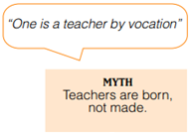
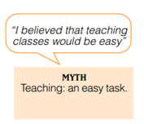
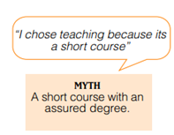
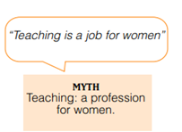
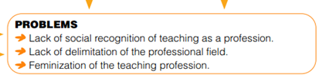
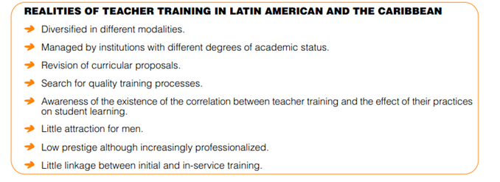
乌拉圭的教师培训项目

Slide 7

乌拉圭的教师培训项目

Slide 8
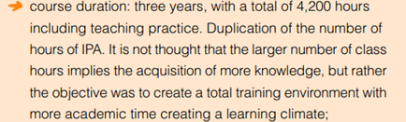

乌拉圭的教师培训项目

Slide 9
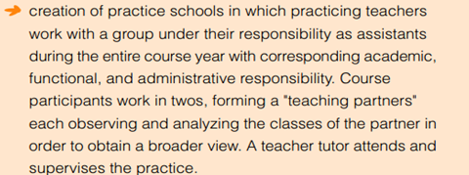
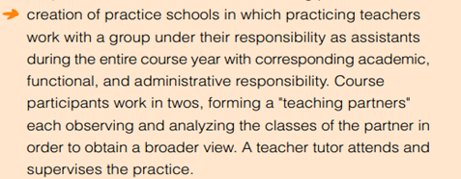
乌拉圭的教师培训项目

Slide 10
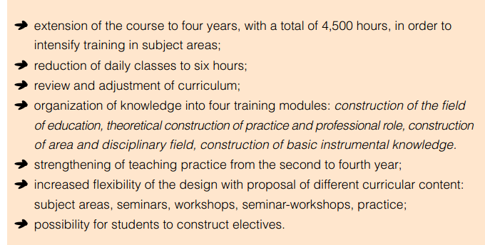
乌拉圭的教师培训项目

Slide 11
教师培训项目
1
乌拉圭的教师培训项目
2
TPD in Pakistan
3
Teachers of the Arctic(IITE)
4
ICT in Education

Slide 12
TPD(Teacher Professional Development ) in Pakistan
Asian Development Bank (ADB)
AIM
Provide knowledge and skills for human development, training infrastructure necessary to help decision makers and stakeholders develop high quality education programs for girls and boys for effective implementation.

Slide 13
TPD(Teacher Professional Development ) in Pakistan
Asian Development Bank (ADB)
(i) an expanded teacher training system to solve the teacher shortage
(ii)increased access to training, especially for women in rural and disadvantaged areas
(iii) improved quality of teacher training programs
(iv) improved planning, management, and efficiency of teacher training institutions

Slide 14
TPD(Teacher Professional Development ) in Pakistan
Middle School Project
AIM
improving access to and participation in middle schooling in rural and urban slum areas, especially for girls; and improving the quality of education.

Slide 15
TPD(Teacher Professional Development ) in Pakistan
Middle School Project
(i)assist rural female matriculates to qualify as middle-school teachers
(ii)reform the middle-school curriculum and textbooks
(iii)retrain teachers and head teachers

Slide 16
TPD(Teacher Professional Development ) in Pakistan
Technical Education Project
AIM
improve the quality of technical education.
(i)Teacher training for upgrading the skills
(ii)establishment of a Bachelor in Education Degree
(iii)strengthening of technical teacher training centers

Slide 17
TPD(Teacher Professional Development ) in Pakistan
Second Girls Primary Education Project
AIM
providing accessible and good-quality primary education to increase the participation and retention rates of girls in rural areas.
improved access to good-quality primary education through quality improvement interventions in interactive radio instruction (IRI) and instructional materials (IM)

Slide 18
TPD(Teacher Professional Development ) in Pakistan
Decentralized Elementary Education in Sindh
AIM
increase access to a pro-poor decentralized public elementary school system.
In-service training of master trainers and new class 6- 8 teachers in curriculum and pedagogy, to be carried out at the district level with special emphasis on madrasah education, English language, and life skills training

Slide 19
教师培训项目
1
TPD in Pakistan
2
乌拉圭的教师培训项目
3
Teachers of the Arctic(IITE)
4
ICT in Education

Slide 20
Teachers of the Arctic(IITE)
purpose
Modernize the Education system by training a new type of teacher.
Lay the foundations for what will be a partnership with countries having circumpolar populations.
goals
Ensure that school-aged children enjoy a quality of schooling comparable to what is available in sub-Arctic settings while at the same time being more in tune with Arctic community realities.

Slide 21
Teachers of the Arctic(IITE)
Two-pronged approach
Ministry
School
Relevance and cost-effectiveness
Changes in the classroom must be internally driven
Reliable database
Head teacher
A computer-based information management system: EMIS
Being properly trained, can bring about real change by providing sustained support to classroom teachers
Enjoys the respect of the community and can enlist its active participation
Knows and enjoys the trust of the staff and students of the school

Slide 22
Teachers of the Arctic(IITE)
design
full stakeholder involvement
prepare/finalize the draft task analysis of the full range of primary/secondary head teacher responsibilities
design and produce the training materials
Module1
Module2
identify and prepare the texts and manuals needed to teach eventual life skills using mobile devices
Module3
be responsible for identifying relevant resource persons and then, for planning, managing and evaluating all training
be responsible for all monitoring and reporting requirements
arrange for the introduction of EMIS into the work of the Ministry’s planners and statisticians
Module4

Slide 23
教师培训项目
1
TPD in Pakistan
2
乌拉圭的教师培训项目
3
Teachers of the Arctic(IITE)
4
ICT in Education

Slide 24
ICT in Education
Facilitating Effective ICT-pedagogy Integration
The Next Generation of Teachers (Next Gen) project
ICT in Education Teacher Training Modules for Developing Countries
Training and Professional Development of Teachers and Other Facilitators for Effective Use of ICTs in Improving Teaching and Learning
Bridging the Within-Country Digital Divide in Education: Improving Education in Western China through Innovative Use of ICT
Training of teachers in information technology in Sri-Lanka
Establishing effective use of ICT in EFA in Cambodia

Slide 25
Next Gen
项目背景
技术和经济的快速发展，公司需要员工有利用信息和通信技术（ICT）的能力
为多变的社会培养学生要求教师自身要掌握新的技能
Teacher Education Institutions和学校倍感压力
项目时间
3年
开始时间
2006年

Slide 26
Next Gen
项目组织者
Teacher Education Institutions (TEIs) （the ICT in Education Unit of UNESCO）
主要合作者
Microsoft (initiating partner) 、Cisco Systems、 Japanese Funds-in-Trust、SMART Technologies Inc

Slide 27
Next Gen
项目目标
enable the next generation of post-primary teachers in the Asia-Pacific region to exploit the benefits of ICT to enhance teaching and learning
实施办法
design and provide training courses on ICT-pedagogy integration
预期成果
trainee-teachers in TEIs across the region will learn a variety of instructional approaches utilizing ICT and will gain the flexibility required to bring the benefits of ICT into classrooms and improve the quality and reach of education

Slide 28
Next Gen
Phase One
Project establishment and launching of the project.
Phase Two
Situation and Needs Assessment of the participating Teacher Education Institutes (TEIs).
phases
Phase Three
Design, development and implementation of a set of interventions for the TEIs.
Phase Four
Evaluation and sharing of success stories and problems faced during the implementation phase.

Slide 29
Next Gen
teachers
pupils
TEIs
预计beneficiaries
Policy makers
National governments

Slide 30
Next Gen
10 countries
30 TEIs
Hundreds of trainee-teachers
参与者

Slide 31
Next Gen(Scaling-Up)
goals
increase the number of participating countries and TEIs in the following activities：
Enhancing the leadership of deans and directors of TEIs in planning and creating an ICT-based teacher training environment, managing ICT-related training programmes and supporting instructors’ professional development;
Catalyzing the efforts of TEIs self-led ICT-related curriculum reform for pre-service teachers;
Building the capacity of teacher educators in designing, providing and managing teacher training activities on ICT-pedagogy integration, and facilitating their collective professional development on ICT-integration.

Slide 32
Bridging the Within-Country Digital Divide in Education: Improving Education in Western China through Innovative Use of ICT
Implementing agencies
UNESCO coordination and guidance through UNESCO Bangkok
National level: National New JIP Joint Co-ordination Group
Provincial level: JIP Project Office
County/city level: County/City JIP Leadership Group
regions
Gansu, Qianghai, and Ningxia/Guizhou
duration
2003-2006

Slide 33
Bridging the Within-Country Digital Divide in Education: Improving Education in Western China through Innovative Use of ICT
needs
favorable supportive policy environment
up-graded skills of teachers and other facilitators
locally relevant approaches to ICT application to education
school nets for resources sharing.

Slide 34
Bridging the Within-Country Digital Divide in Education: Improving Education in Western China through Innovative Use of ICT
problems
local government officers and community leaders
policies
teachers
competencies and training
maintenance of computers
purchasing of necessary softwares
ICT infrastructure
IT courses
basic programming language
chalk-talk lecturing
examination-driven education system
Teaching and learning

Slide 35
Bridging the Within-Country Digital Divide in Education: Improving Education in Western China through Innovative Use of ICT
headmasters
teachers
students
Community leaders
beneficiaries
Officers of the local education departments

Slide 36
Bridging the Within-Country Digital Divide in Education: Improving Education in Western China through Innovative Use of ICT
strategies
in-service training for teachers and headmasters
curriculum renewal
development of innovative and modern textbooks
research and evaluation
networking among JIP schools

Slide 37
Training and Professional Development of Teachers and Other Facilitators for Effective Use of ICTs in Improving Teaching and Learning
aims
improve the capabilities of pre-service and in-service teachers and facilitators to utilize ICT as pedagogical tools and educational resources
Participating countries in the Asia-Pacific region
Afghanistan, Fiji, India, Indonesia, Kazakhastan, Lao PDR, Malaysia, Mongolia, People's Republic of China, Philippines, Thailand and Viet Nam.
Target beneficiaries and partners
Teachers, school administrators, education policy makers, and other facilitators of ICT use in education
duration
2003-2007

Slide 38
Training of teachers in information technology in Sri-Lanka
Implementing agencies
the Ministry of Education
Region/country
Sri Lanka
Target beneficiaries and partners
a) Students of schools who sit for GCE (O/L) in 2004. (Such schools should conform to the requirements of IT education infrastructure).
b) ICT professionals
c) R&D institutions in ICT
d) Private Sector Organizations involved in ICT enabled Education
e) State Institutions in Educational Research and Training
f) National Institute of Education, Maharagama.
g) National Open University
duration
2 years

Slide 39
Facilitating Effective ICT-Pedagogy Integration Project
goals
create an enabling environment that facilitate students’ direct and effective use of ICT for more meaningful and productive learning activities, with a specific focus on project-based telecollaboration
Project Implementation
Project Management and Internal Capability Building
Capacity Building on Project-Based Learning (PBL) and Telecollaboration and Follow-up / Monitoring Activities
Regional Trainers’ Training Workshops
Regional Policy-Level Meetings
Fund Mobilization for National Initiatives

Slide 40
Thank You !

