Slide 1
Using ubiquitous games in an English listening and speaking course: Impact on learning outcomes and motivation
Tsung-Yu Liu ,Yu-Ling Chu
Computers & Education 55 (2010) 630e643

Slide 2
A context-aware ubiquitous learning environment for language listening and speaking
Tsung-Yu Liu
Journal of Computer Assisted Learning (2009), 25, 515–527

Slide 3
目录
a. 研究议题-研究背景、研究动机、重要性 b. 文献探讨 c. 研究方法与结果: 自变项、依变项、研究设计、评量方法、研究结果 d. 讨论与建议: 研究发现之贡献与启示 e.反思、启发

Slide 4
a. 研究议题-研究背景、研究动机、重要性
English is the most popular language in the world and has become the most important foreign language in many non-English-speaking countries.
Factors which may influence learners‘ language learning (Chamot, 1987; Reiss, 1983), such as age, gender, motivation, personality, learning styles, and learning strategies, have an influence on learners’ language learning outcomes. The use of language learning strategies (LLS) is considered to be an important one.
Using appropriate learning strategies and developing effective learning activities which support English learning is an important topic in the field of computer-assisted language learning (CALL)
M-learning has many advantages over e-learning, including flexibility, mobility, convenience, low cost, and userfriendliness. (MALL) → enhancing vocabulary and reading ability
Few investigations have delved into the relationship between learning strategies, learning achievement, and the application of MALL in English speaking and listening courses.

Slide 5
a. 研究议题-研究背景、研究动机、重要性
现实问题：
1.students lack sufficient opportunity to practice conversation with their English teachers, classmates, and native English speakers.
2. schools lack appropriate English learning tools (including software and hardware) for coaching individual listening and speaking.
3. students lack courage to speak, since they are worried about their classmates laughing at them due to their poor English skills.
解决方案：
strives to devise low-cost methods of designing an effective English learning environment and adopt appropriate learning strategies in designing an effective curriculum for countries with no relevant educational policy or sufficient financial backing.

Slide 6
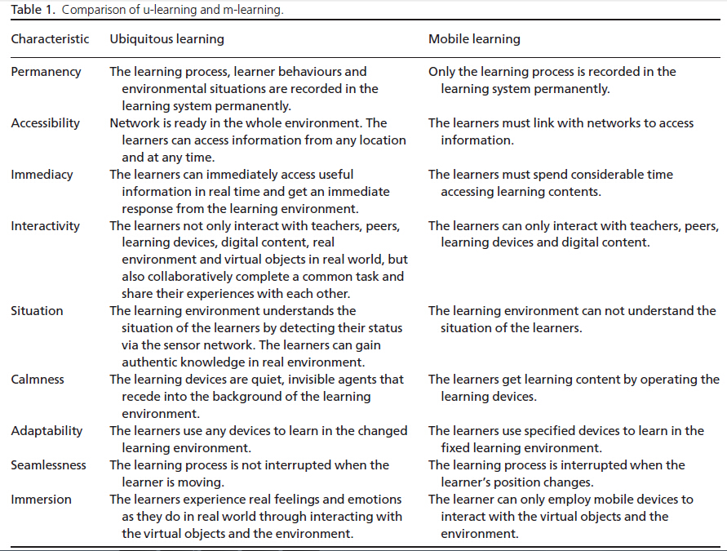
b. 文献探讨

Slide 7
b. 文献探讨
How can effective learning activities be developed to enhance learning outcomes and motivation?
How can a low-cost English learning environment be created in a real situation?
What is the difference between the learning outcomes of our proposed learning method and those of the traditional learning method in English learning?
What is the difference between the learning motivation behind our proposed learning method and that behind the traditional learning method in English learning?
What is the relationship between learning outcomes and learning motivation?

Slide 8
c. 研究方法与结果: 研究设计、评量方法、研究结果

Slide 9
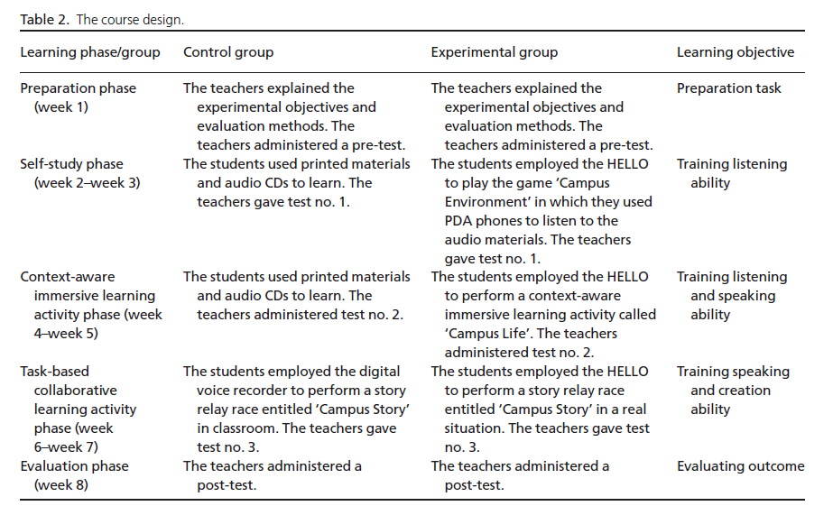
c. 研究方法与结果: 研究设计、评量方法、研究结果

Slide 10
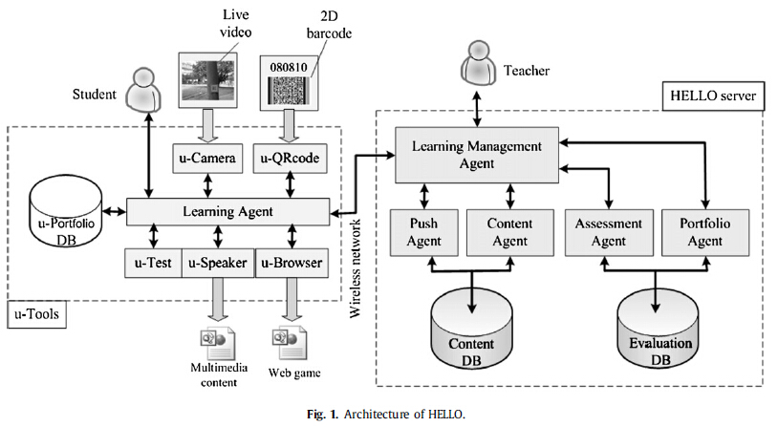
c. 研究方法与结果: 研究设计、评量方法、研究结果

Slide 11
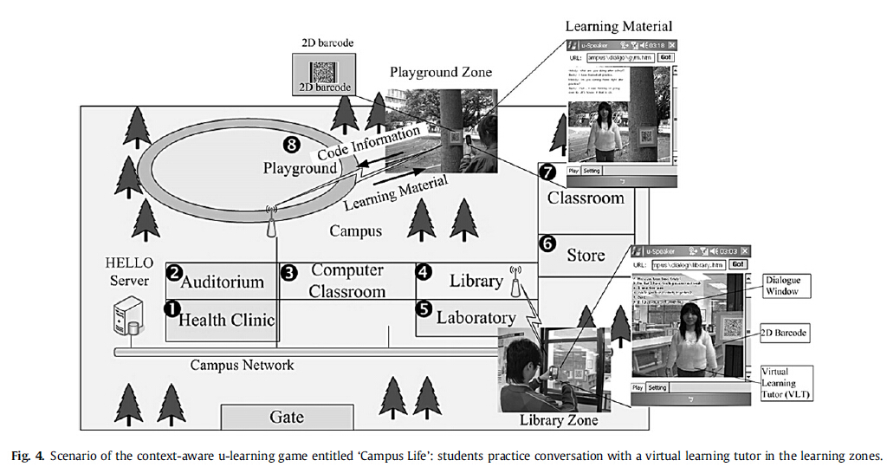
c. 研究方法与结果: 研究设计、评量方法、研究结果

Slide 12
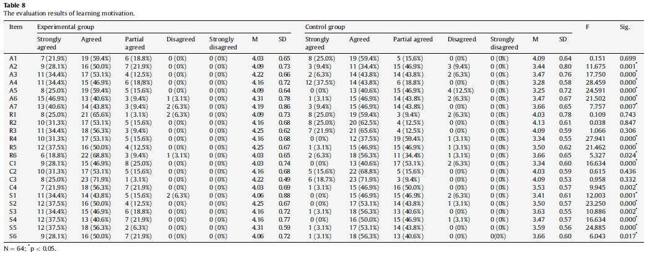
c. 研究方法与结果: 研究设计、评量方法、研究结果
Learning outcomes
Learning motivation

Slide 13
c. 研究方法与结果: 研究设计、评量方法、研究结果
Learning outcomes & motivation
using ubiquitous games in learning could achieve a better learning performance and motivation than non-gaming learning. Most of the students in experimental group stated that they were afraid of talking with English teachers but were not at all afraid of talking to the VLT. Even if they made a mistake, the VLT only told them the correct sentence without laughing at them openly. Therefore, they felt satisfied with their achievement in the ubiquitous games.

Slide 14
d. 讨论与建议: 研究发现之贡献与启示
SPSS ,significance level was set at p < 0.05 for all statistical analysis, as is standard practice.
The learning performance was taken from the experimental and control group students' test scores. This study adopted Cronbach's
a coefficient in order to evaluate the internal consistency reliability of the tests. 0.7 is an acceptable minimum reliability coefficient. We conducted ANCOVA with a pre-test as a covariate to investigate the outcomes of students in different groups.
The learning motivation and learner satisfaction of the statistical results of the questionnaire were obtained using a one-way ANOVA.Descriptive statistics.
The qualitative data included the responses from the audio records obtained form an in-depth interview. Analytic procedures organizing
the data; generating categories, themes, and patterns; testing the emergent hypotheses against the data; searching for alternative
explanations for the data; and writing the report (proposed by Marshall & Rossman (1989))were adopted to analyze the qualitative data
obtained in this study.

Slide 15
e.反思、启发
泛在学习理论研究综述,潘基鑫,中国远程教育
Marshall & Rossman (1989) 质性研究

