Slide 1
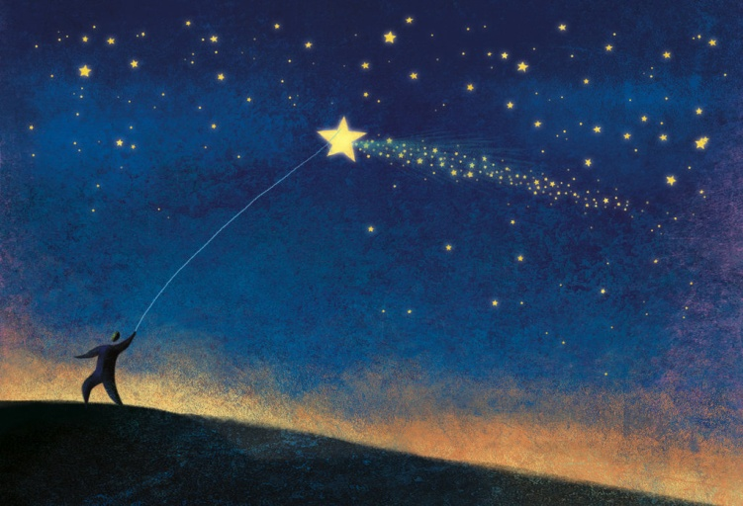
Draw Me
a Star
(Sounds & Letters)
Miss Su
2014.10

Slide 2
I can sing.
I can dance.
I can run.
I can jump.

Slide 3
Who are missing?
Where do they go?

Slide 4
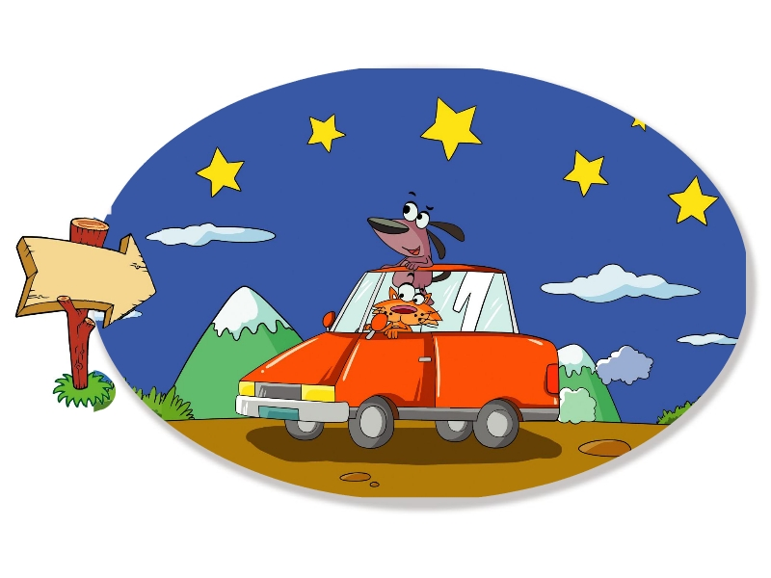

Slide 6
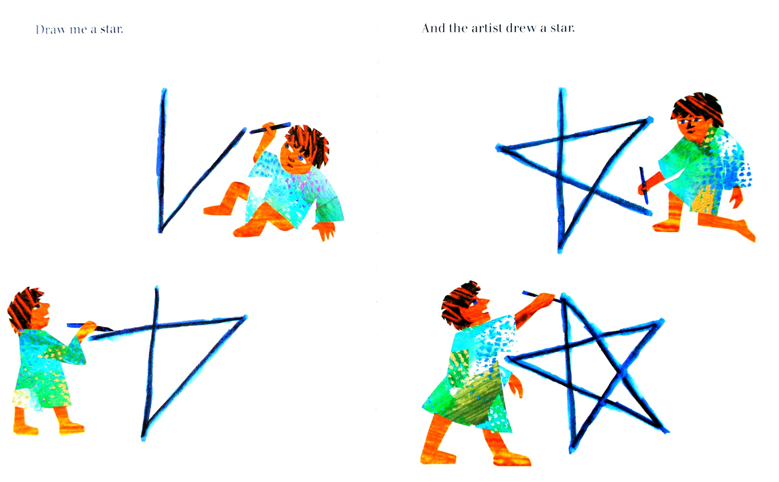

Slide 8
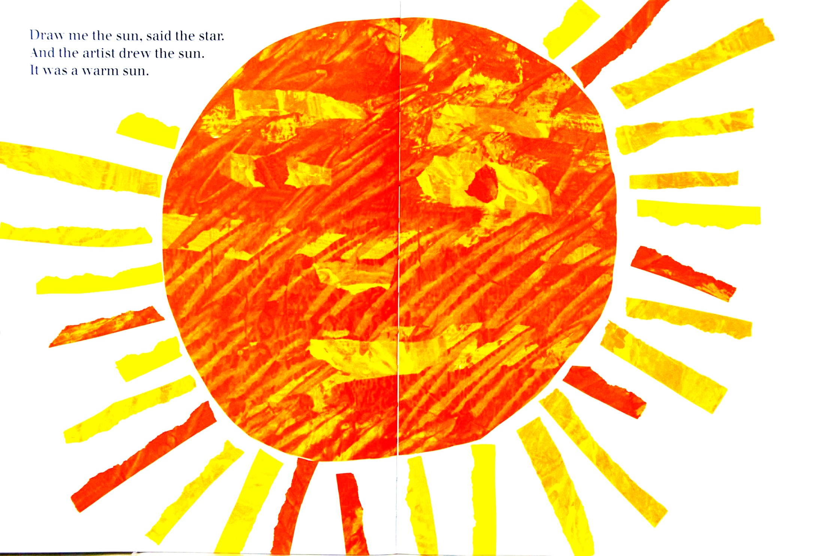

Slide 9
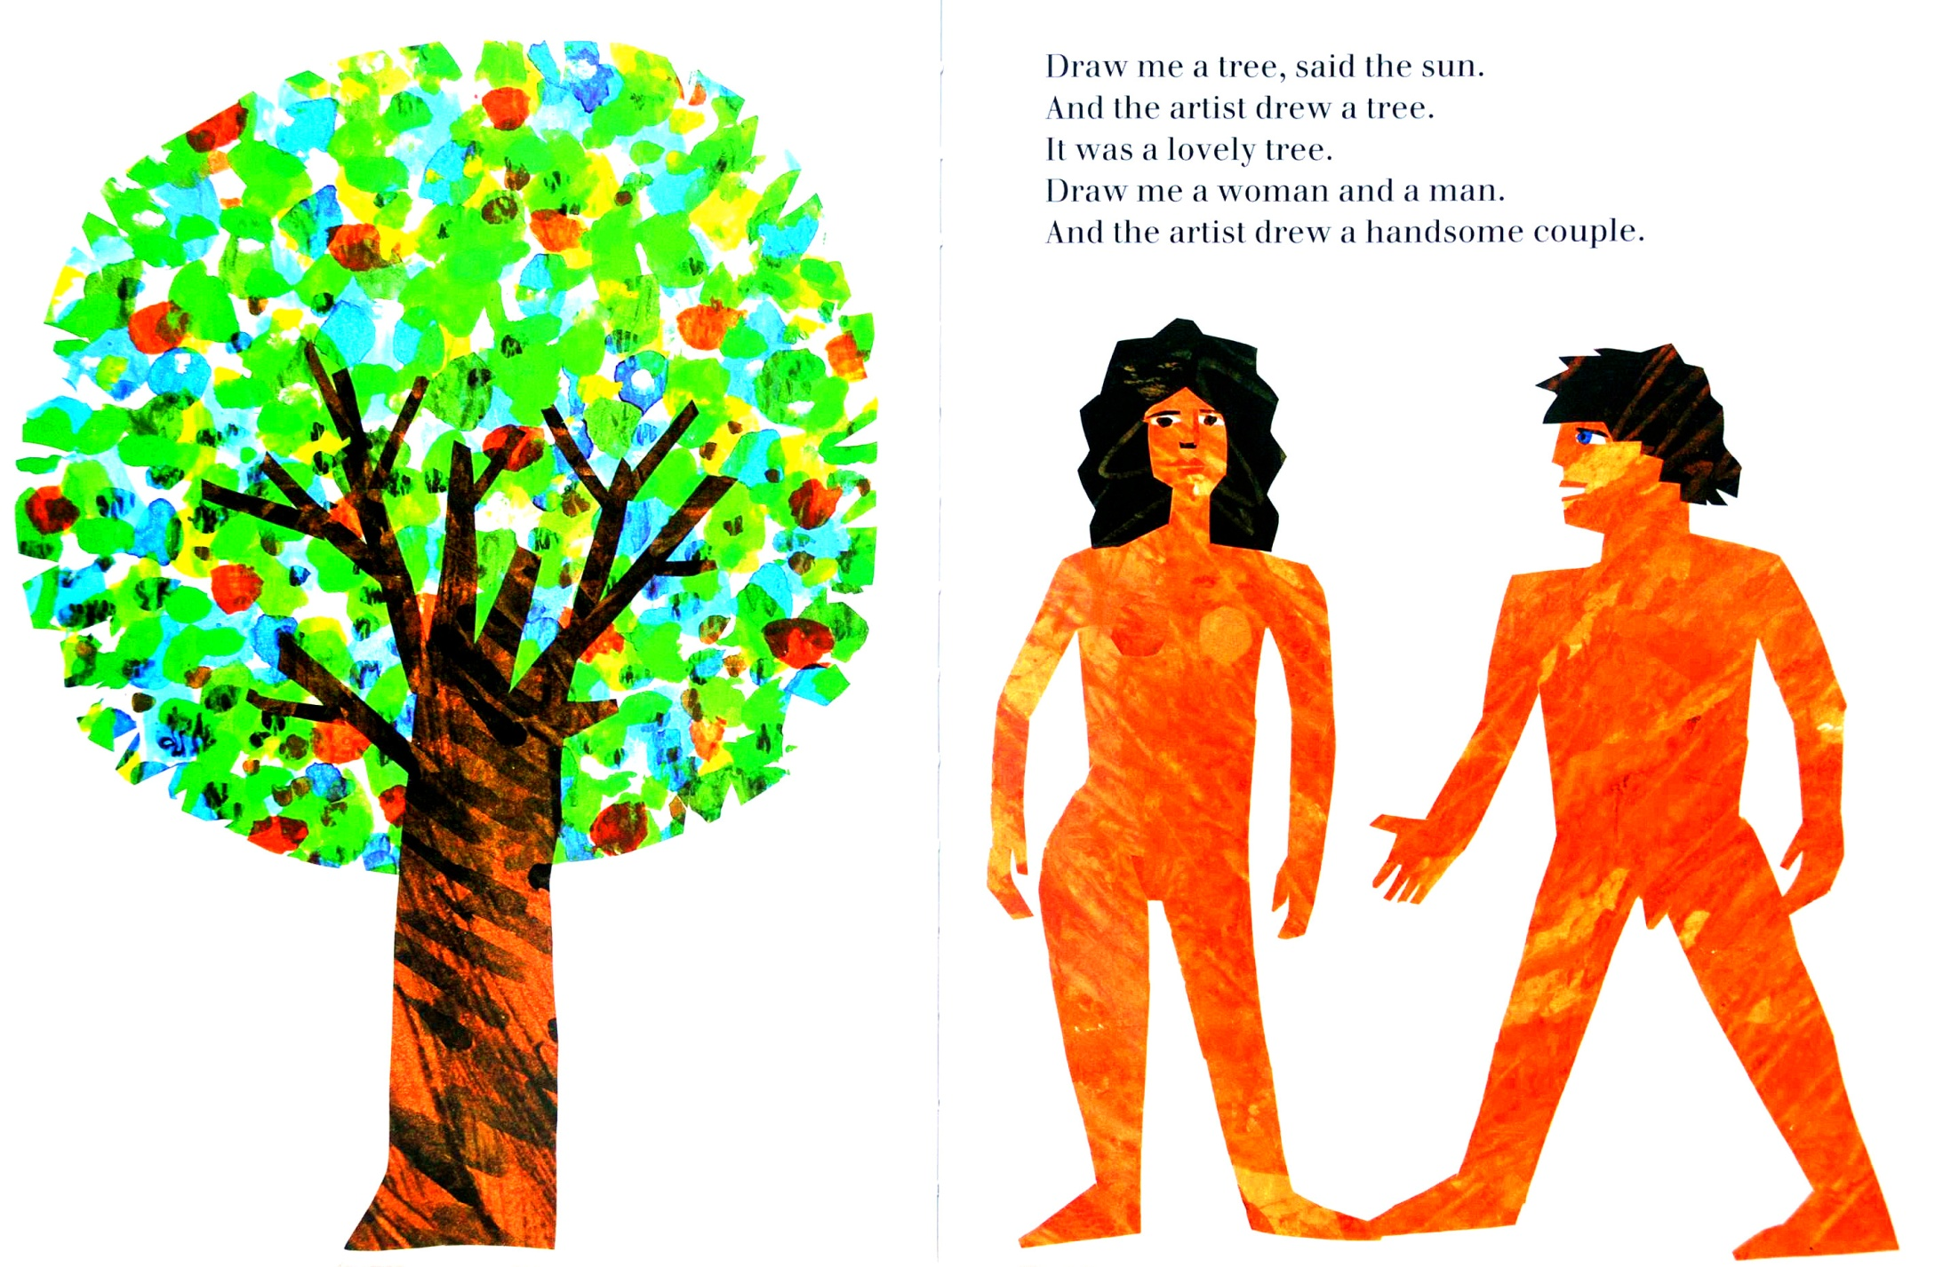

Slide 11
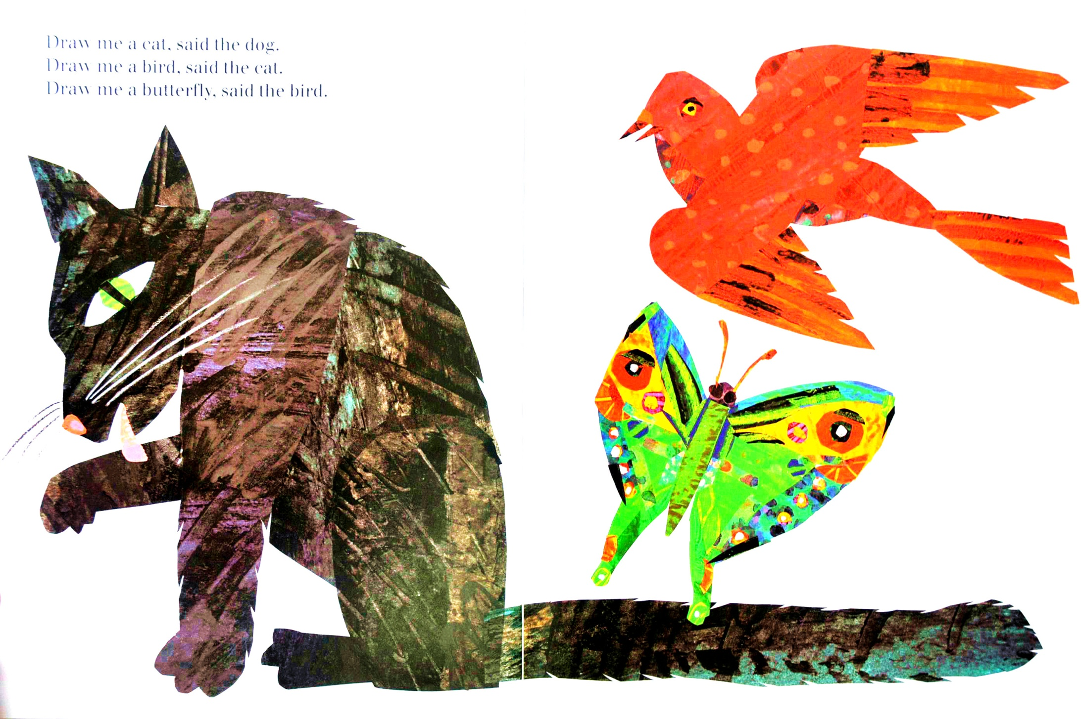

Slide 12
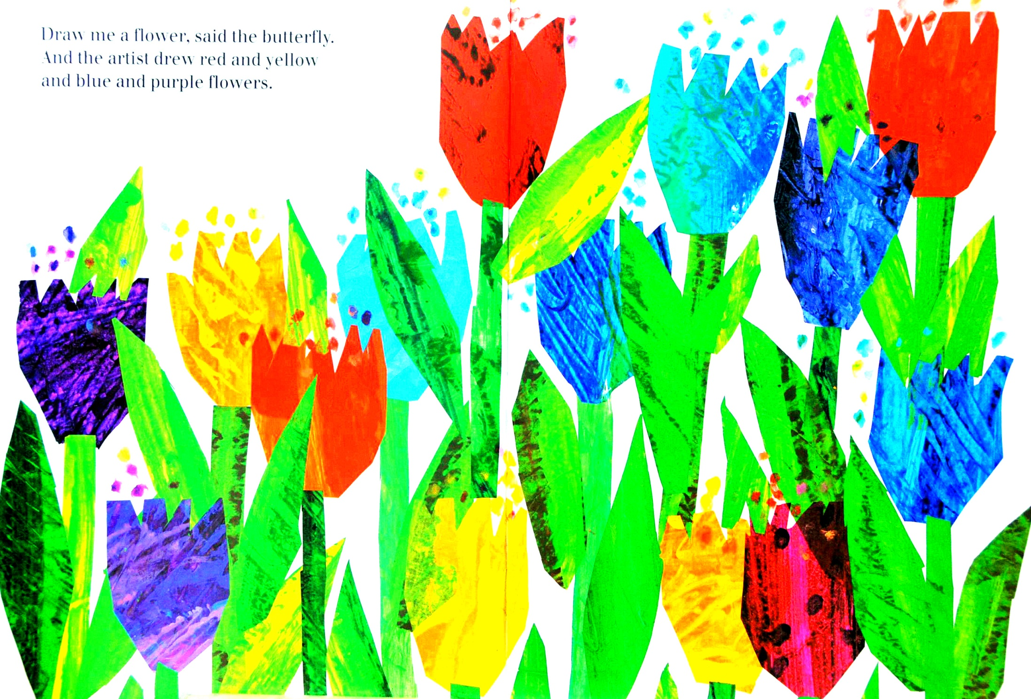

Slide 14
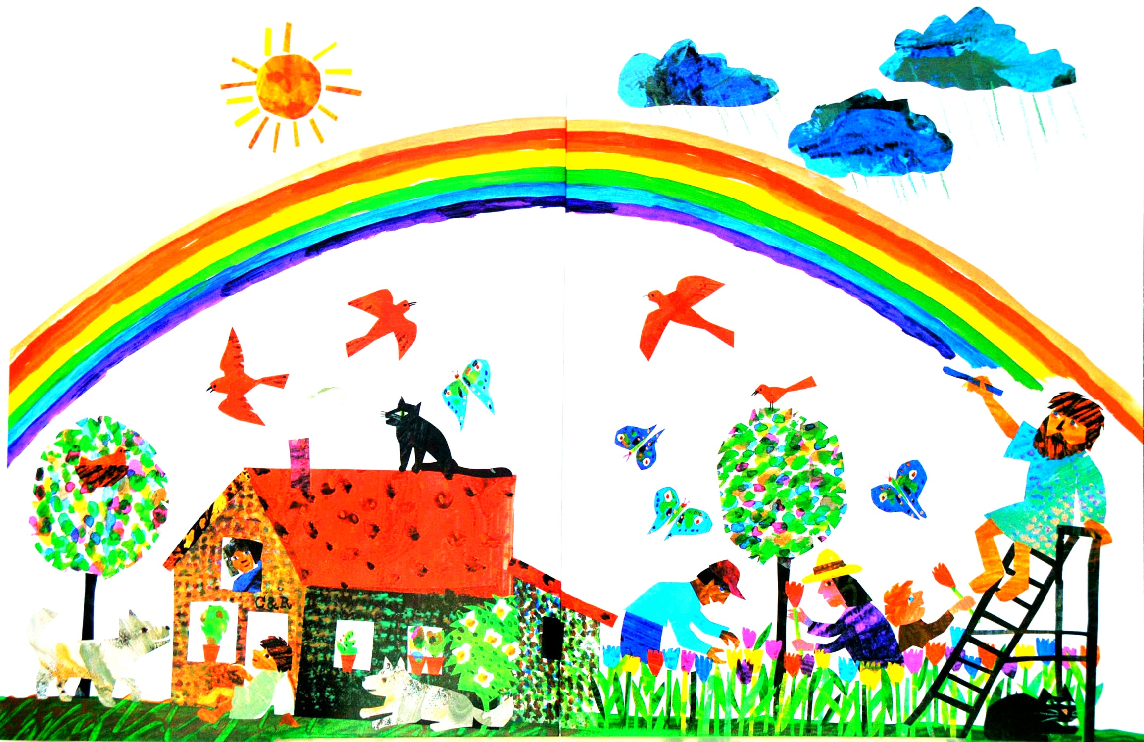

Slide 15
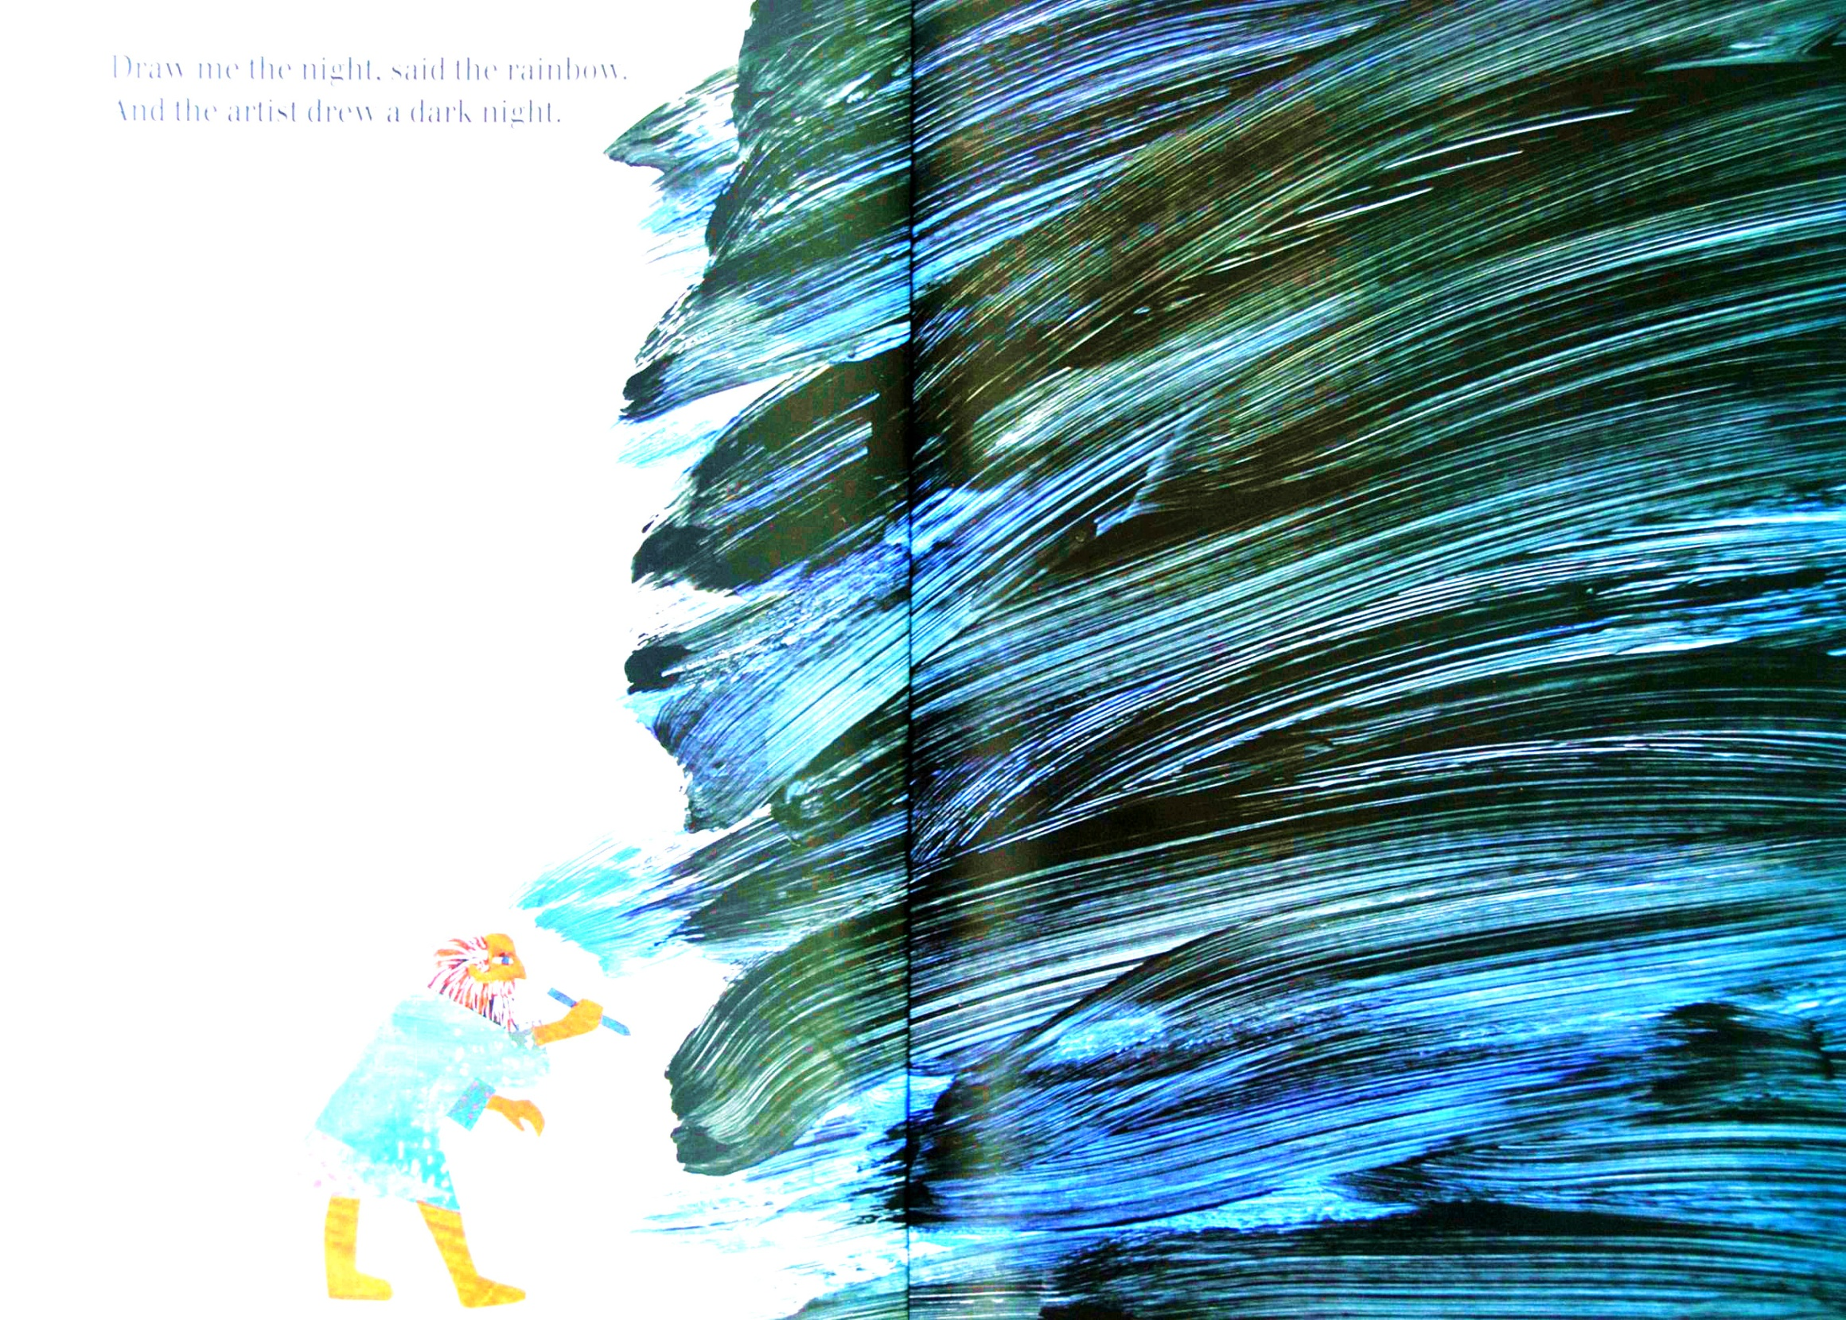

Slide 16
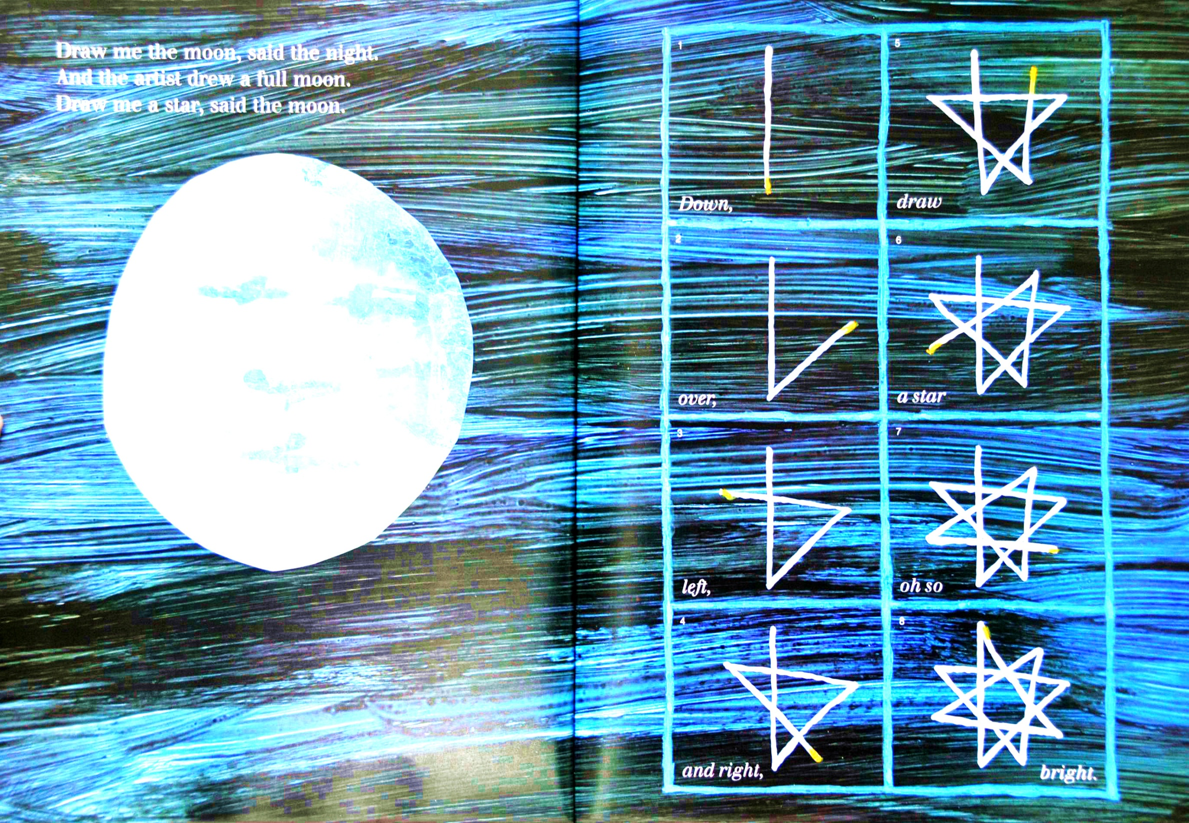

Slide 17
Listen to the story
Play the story

Slide 18
Pair-work:
A: Artist, artist, draw me the …
B: Ok! Ok! I can draw the …
Tips: 1. work in pairs.
2. Use the sentences to ask your partner to draw something for you.
3. Words you can use: car, bar, star, grass

Slide 19
Homework:
Use the words: car, star, park, grass, to draw a picture.

